Slide 1
MathSec: Design and Implementation of Novel
MAPTCHA Algorithms for Establishing Secured Access
Subject: Project-II
Paper Code: CSE 891
Under the Supervision of
Mr. Sumit Gupta
Assistant Professor
Department of Computer Science and Engineering
University Institute of Technology
The University of Burdwan
By
Arnab Das (Roll no.-2014-1011, Regn. No.- A2360 of 2014-15)
Saikat Sar (Roll no.-2014-1070, Regn. No.- A2409 of 2014-15)
Suraj Mondal (Roll no.-2014-1071, Regn. No.- A2410 of 2014-15)
Durlov Ghosh (Roll no.-2014-1012, Regn. No.- A2361 of 2014-15)

Slide 2
Agenda
Introduction
Previous Work
Proposed Work
Implementation
Result and Analysis
Future Work
Conclusion
References

Slide 3
Introduction
CAPTCHA -> Completely Automated Public Turing test to tell Computers and Humans Apart.
Two main requirements : Robustness and Usability
Robustness :- Strength to defend against different kinds of attacks.
Usability :- The ease with which humans pass its challenges.
MAPTCHA -> Mathematical CAPTCHA
In our project, we have proposed two versions of our own MAPTCHA algorithm i.e. “MathSec” which overcome some disadvantages of previously proposed MAPTCHA algorithms.

Slide 4

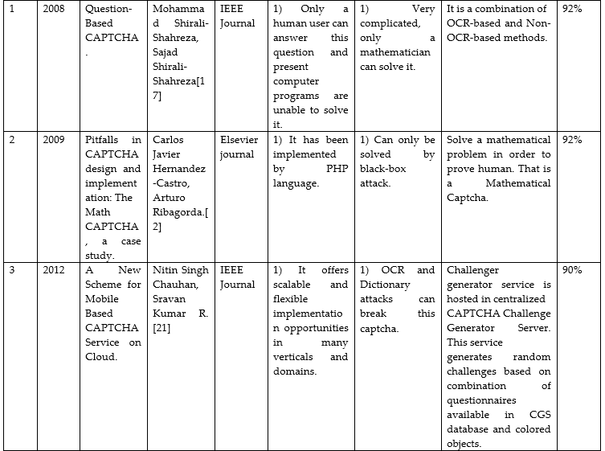
Previous Work
Table 1: Comparative study of existing CAPTCHA systems
Comparative study of existing CAPTCHA systems

Slide 5
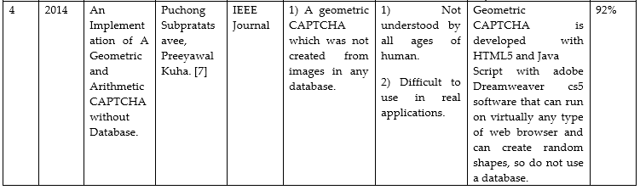
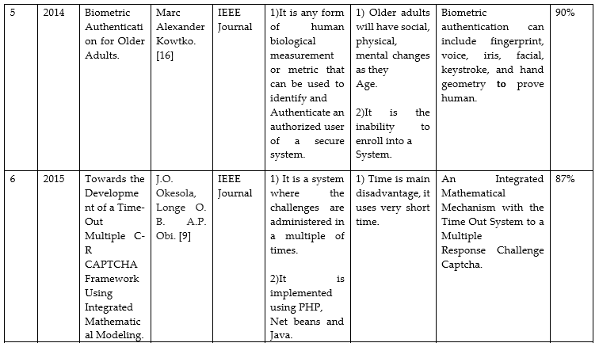
Table 1: Comparative study of existing CAPTCHA systems
Comparative study of existing CAPTCHA systems

Slide 6
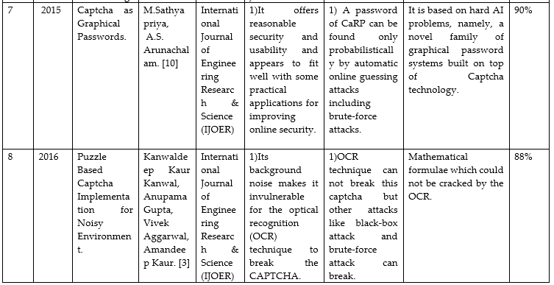
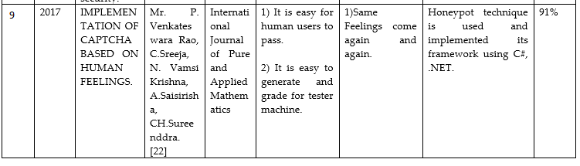
Table 1: Comparative study of existing CAPTCHA systems
Comparative study of existing CAPTCHA systems

Slide 7
Proposed Work
In this project, we have proposed two versions of our own MAPTCHA algorithm MathSec.
MathSec (Version 1)[28] :
Texts rotated at different angles clockwise / anticlockwise which are shown as images to the human in a Registration form.
A particular angle is selected and multiplied with a value generated by random value generator uniformly distributed in the range of 0 to 1.
MathSec (Version 2):
We have taken random text generated by the random text generator, which is merged with integer numbers from 1 to 10.
These merging is done with the numbers deviating to downwards slightly and then overlapping with the random text.

Slide 8
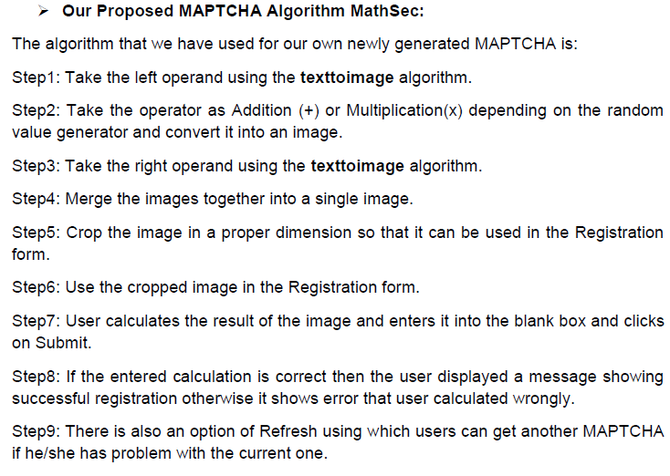
MathSec (Version 1)[28]

Slide 9
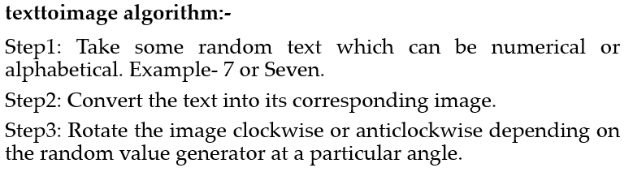
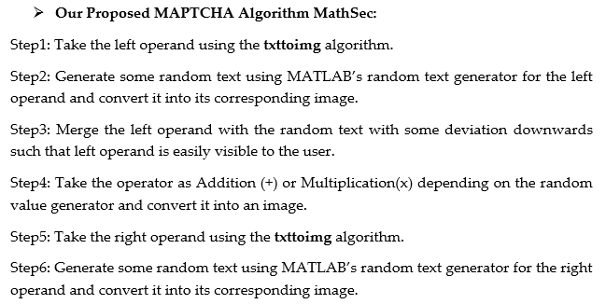
MathSec (Version 2):

Slide 10
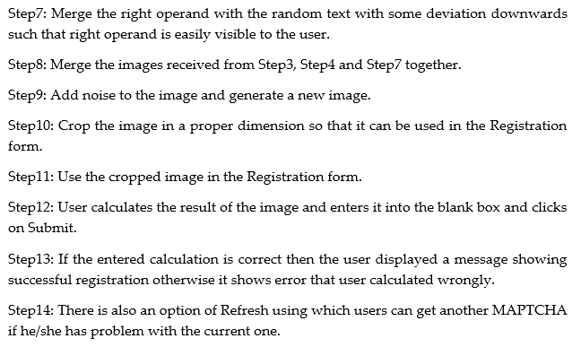
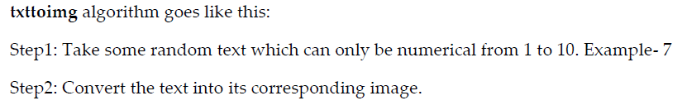
MathSec (Version 2):

Slide 11
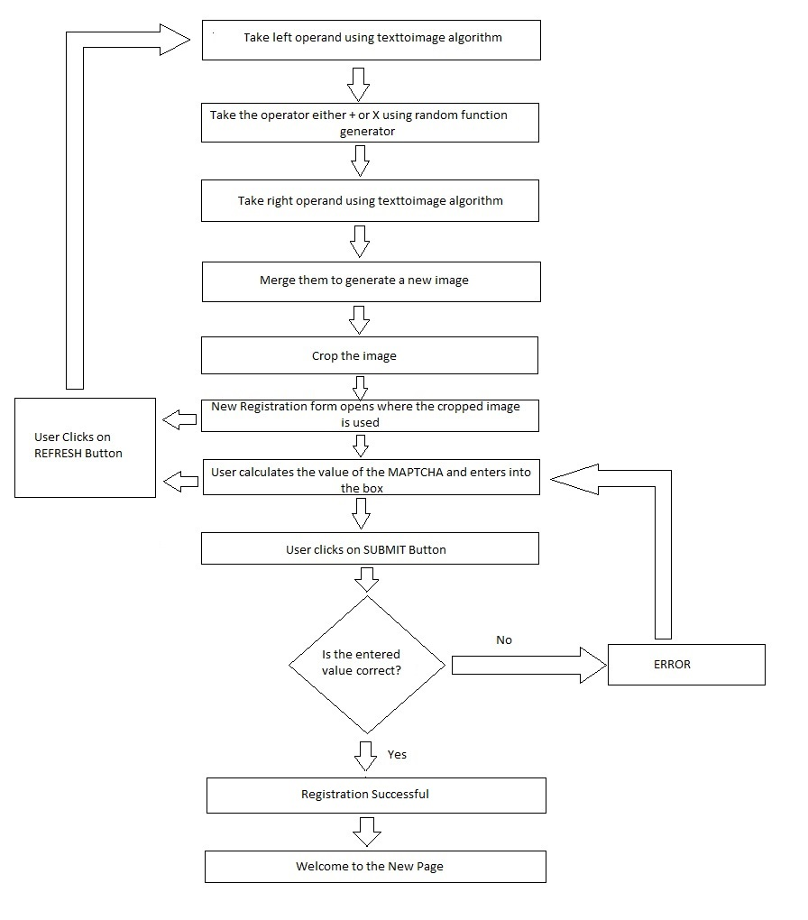
Flowchart of our proposed MAPTCHA Algorithm version 1 :-
Fig 1: Flowchart of our proposed MAPTCHA Algorithm version 1

Slide 12
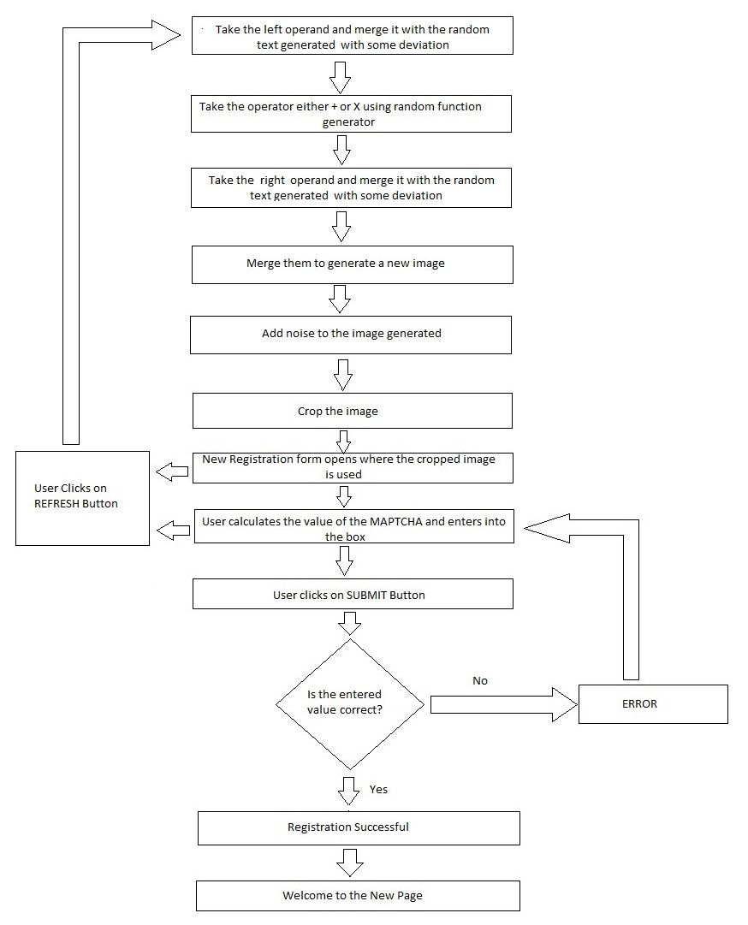
Flowchart of our proposed MAPTCHA Algorithm version 2 :-
Fig 2: Flowchart of our proposed MAPTCHA Algorithm version 2

Slide 13
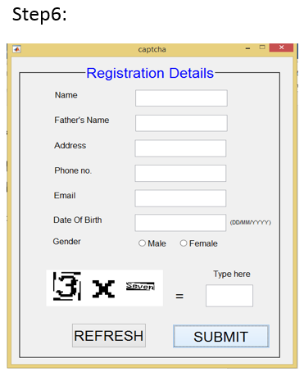
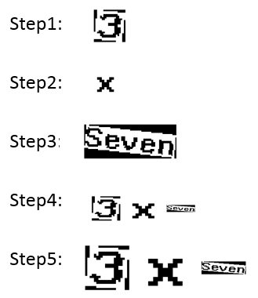
Implementation
MathSec (Version 1)[28] :
Fig 3: Step 1
Fig 4: Step 2
Fig 5: Step 3
Fig 6: Step 4
Fig 7: Step 5
Fig 8: Step 6

Slide 14
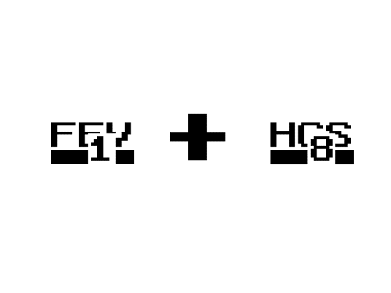
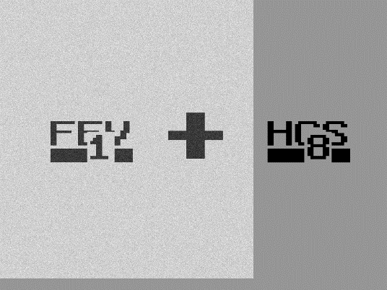

MathSec (Version 2):
Fig 16: Step 8
Step 1:
Step 2:
Step 3:
Step 4:
Step 5:
Step 6:
Step 7:
Step 8:
Step 9:
Step 10:
Fig 9: Step 1
Fig 10: Step 2
Fig 11: Step 3
Fig 12: Step 4
Fig 17: Step 9
Fig 13: Step 5
Fig 14: Step 6
Fig 15: Step 7
Fig 18: Step 10

Slide 15
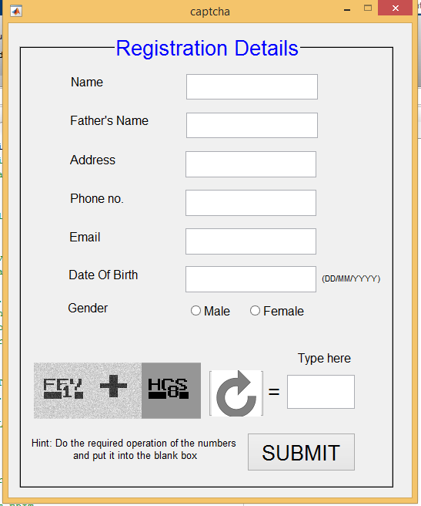
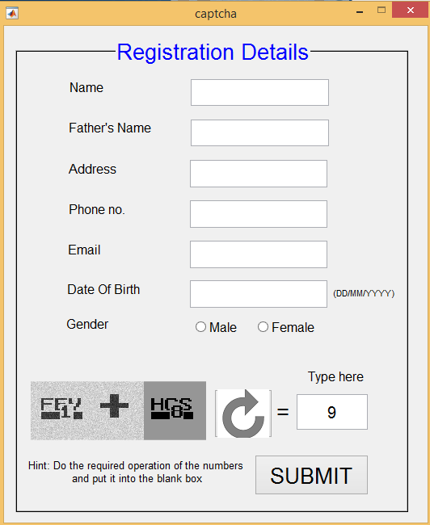
Step 11:
Step 12:
Fig 20: Step 12
Fig 19: Step 11

Slide 16
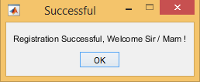
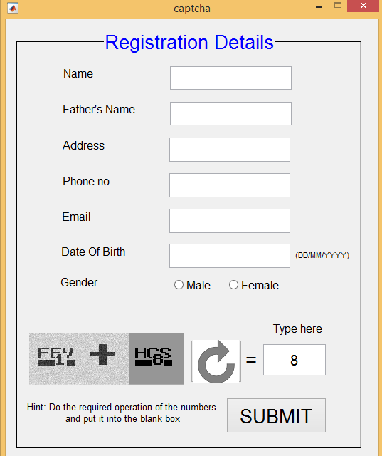
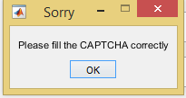
Step 13:
Step 15:
Fig 21: Step 13
Step 14:
Fig 22: Step 14
Fig 23: Step 15

Slide 17
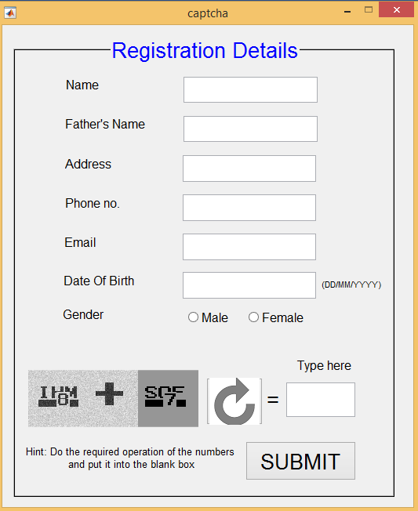
Step 16:
Fig 24: Step 16

Slide 18
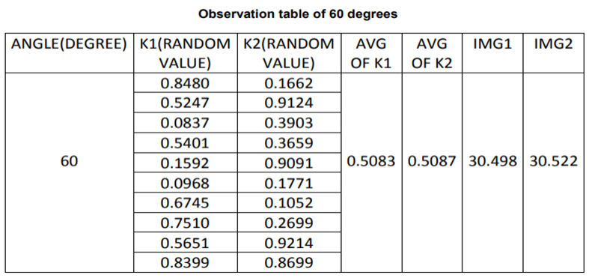
Result and Analysis
MathSec (Version 1)[28] :
Table 2: Observation table of 60 degree
From results of different angles we got that 60 degree gave us good results , So we have chosen 60 degree as the optimum angle for the rotation of operands.

Slide 19
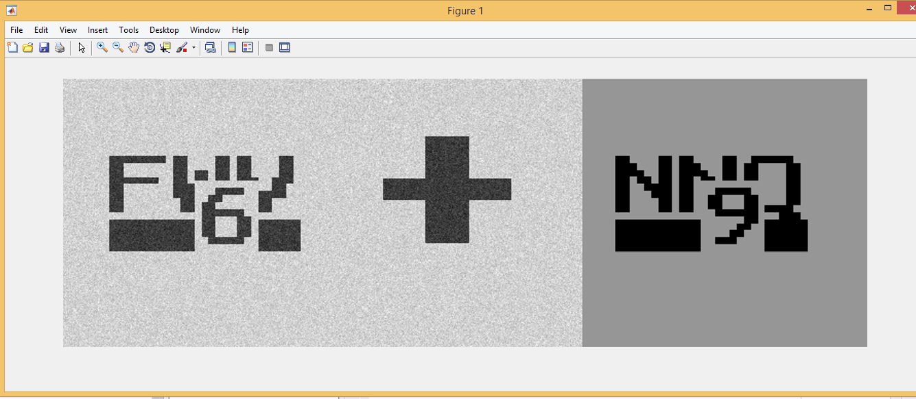
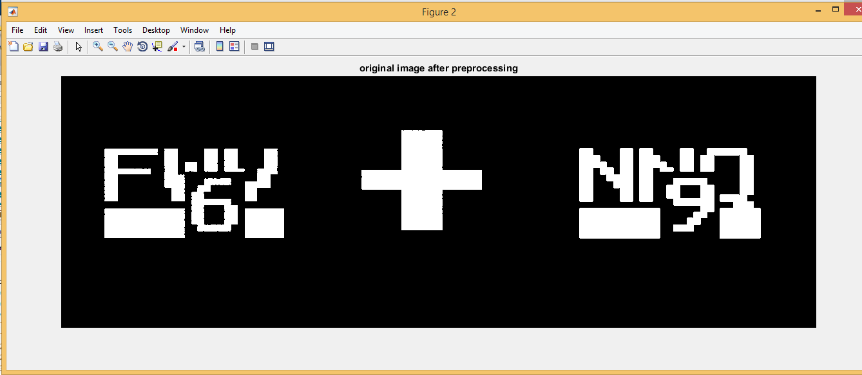
MathSec (Version 2):
Original Image:
Image After Binarization:
Fig 25: Original Image
Fig 26: Image After Binarization

Slide 20
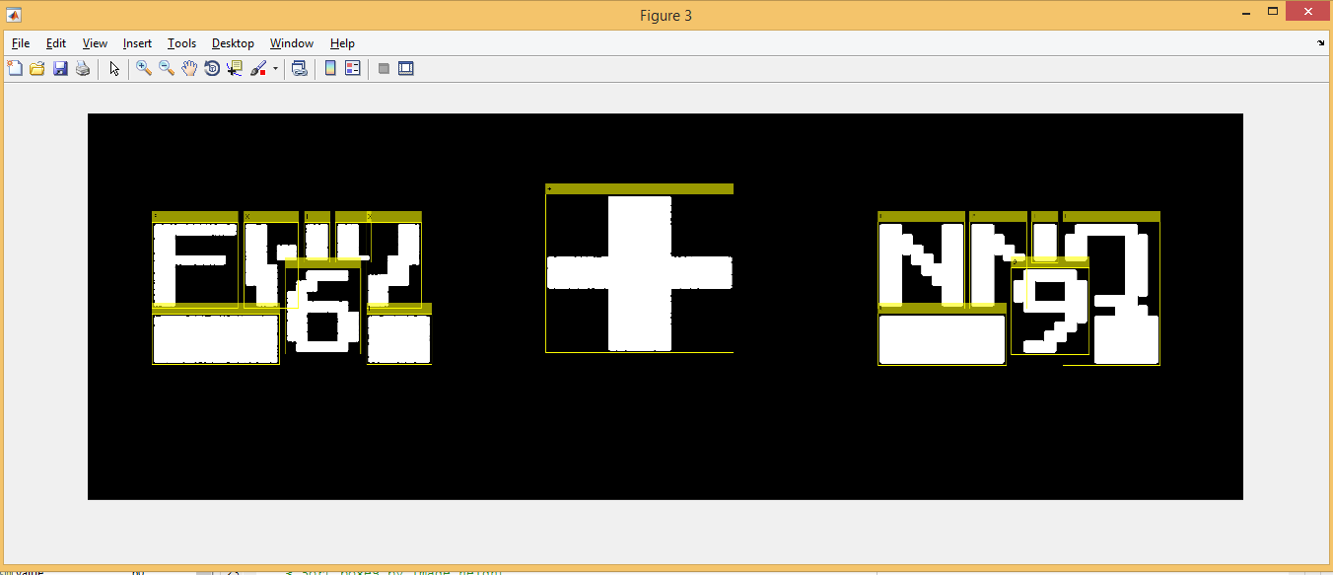
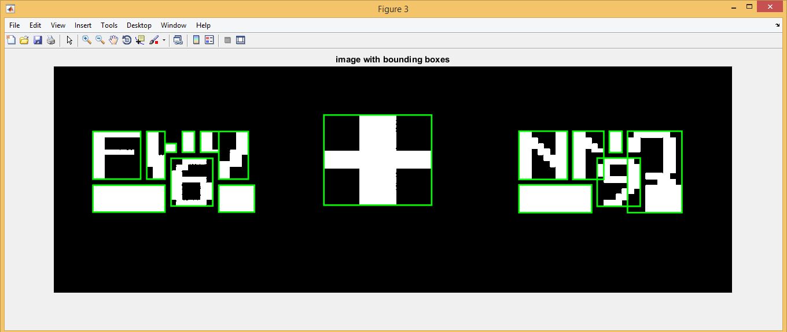
Boundary Boxes:
Using MATLAB OCR specifying character set:
Using MATLAB OCR:
Fig 27: Using MATLAB OCR
Fig 28: Using MATLAB OCR specifying character set

Slide 21
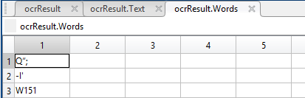
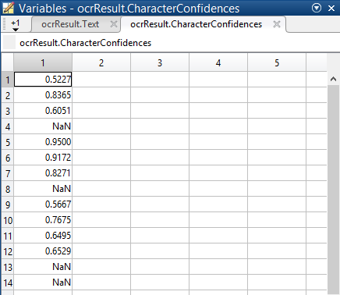
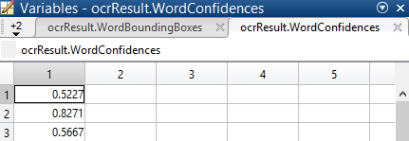
MATLAB OCR:
Words:
Fig 30: Words
Text: Q“; -I' W151
Character Confidences: Shows accuracy/confidence of OCR to detect correctly
Word Confidence:
Fig 29: Character Confidences
Fig 31: Word Confidence

Slide 22
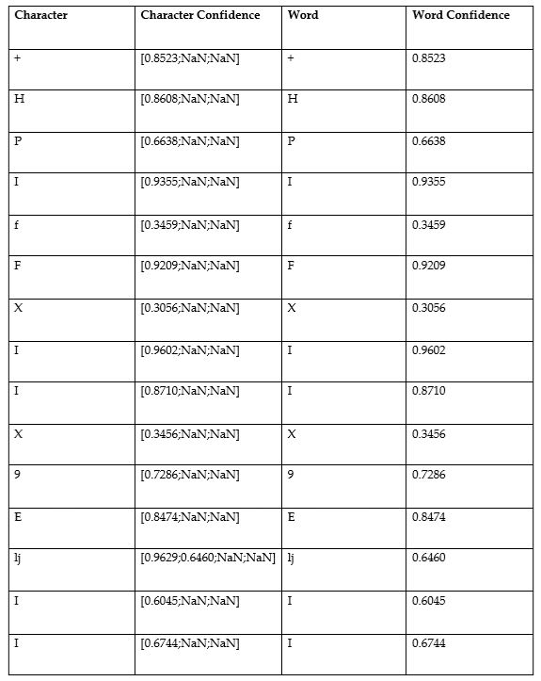
MATLAB OCR specifying character set:
Text: +HPIfFXIlX9EljII
Result Table:
Table 3:Result Table
MATLAB user defined function[24]:
Text: F0T060LZ0TN0L90Q

Slide 23
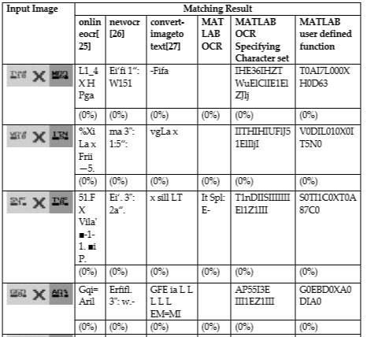

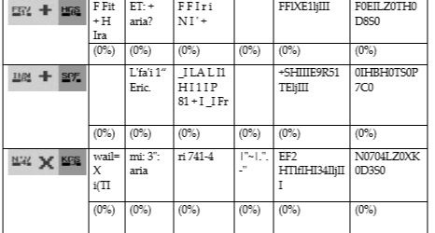
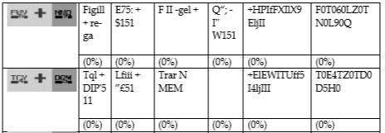
Comparative study of different OCRs and our MathSec algorithm’s efficiency:
Table 4: Study of different OCRs

Slide 24
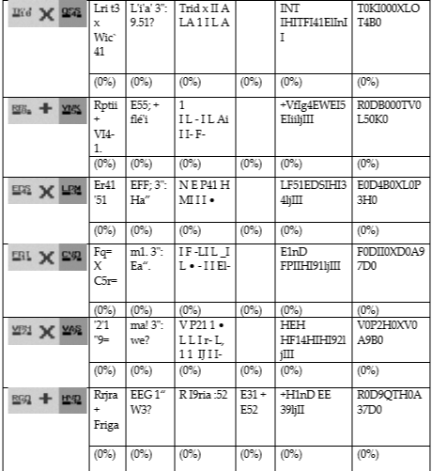
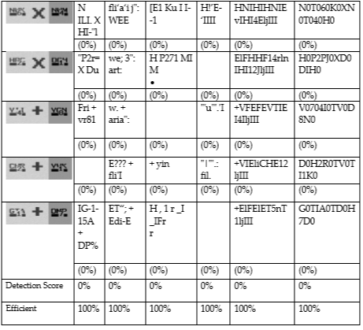
Table 4: Study of different OCRs

Slide 25
Analysis:
Detection score is determined using some rules.
If the OCR can detect the operands and operator correctly without any other characters or numbers then it is 100%.
Otherwise if they can’t detect anything or detects with other characters or numbers then it is 0%.
Efficiency of our algorithm is determined by,
Efficiency = 100- Detection score

Slide 26
Future Scope
In future we will try to make our proposed MAPTCHA algorithm to be more robust and usable.
To make it robust we would like to make it hard to detect the integer numbers of our MAPTCHA made from MathSec algorithm.
For this we would like to do different advanced techniques other than OCR to detect the numbers correctly. If they can detect them easily then we will like to modify our approach of generating MAPTCHA using our MathSec algorithm.
To make it usable we will make it as simple as possible for human to understand.

Slide 27
Conclusion
CAPTCHAs are an effective way to counter bots and reduce Spams.
In this paper we have proposed two different versions of our Mathematical CAPTCHA or MAPTCHA algorithm.
MAPTCHA is a type of CAPTCHA in which users have to calculate the value of the expressions and enter it in the given box. We have implemented our proposed MAPTCHA algorithm and we have found that it is secure and usable.

Slide 28
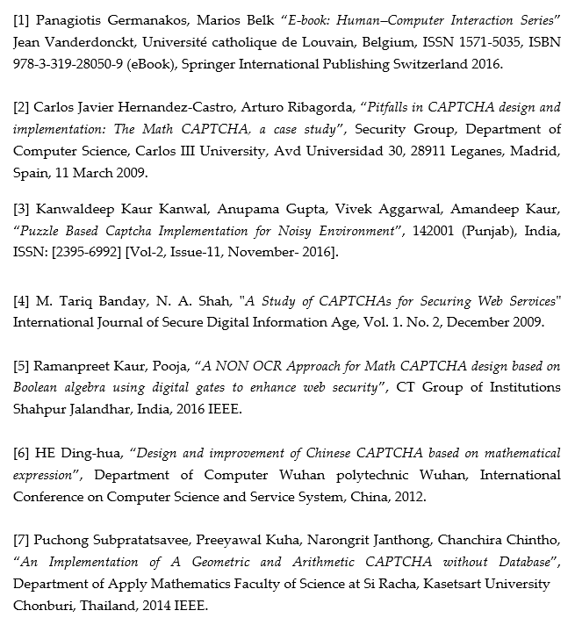
References

Slide 29
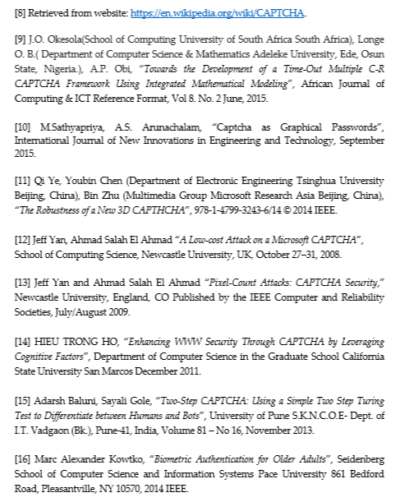
References

Slide 30
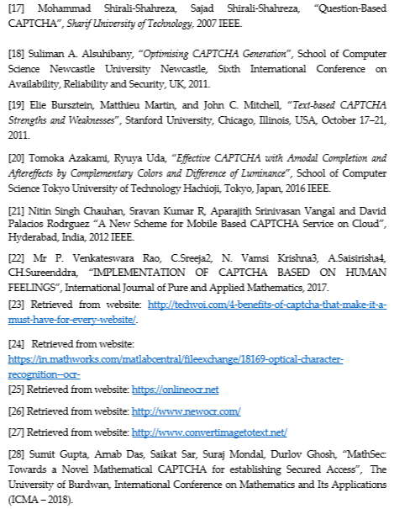
References

Slide 31
THANK YOU! QUESTIONS?

